Slide 1
Object Oriented
Design
Tony Baines
March 2013

Slide 2
Introduction
What this is not
A Methodology
I have nothing to sell you
A Process
If it was repeatable, the computers would do it
… but it will be
A vocabulary for talking about design
Some principles for spotting good (and bad) design

Slide 3
What do you think of When you think of OO?
Inheritance
Data and Methods
Encapsulation
Polymorphism
Coupling
Cohesion

Slide 4
Context
We build systems to solve a problem
We write (design) software to talk to other people
The CPU doesn't care about style
Communicating intent in code is hard
A kind of mind-reading
Object Orientation is a mindset for humans
Good OO projects the understanding of the team

Slide 5
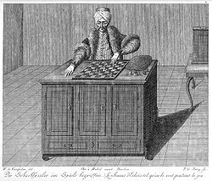
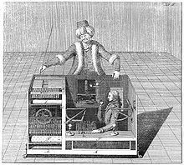
Foundation Concepts
Encapsulation
State and Operations together
Messages go in
Messages come out
How does it work?
Notes:
A fake chess-playing machine constructed in the late 18th century by Wolfgang von Kempelen to impress the Empress of Austria, the mechanism appeared to be able to play a strong game of chess against a human opponent

Slide 6
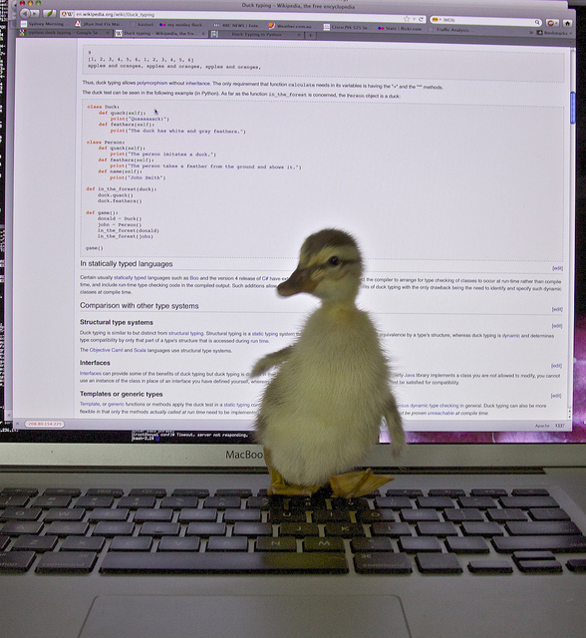
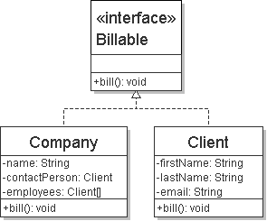
Foundation Concepts
Polymorphism
'Many Shaped'?
One shape on the outside
Different innards

Slide 7
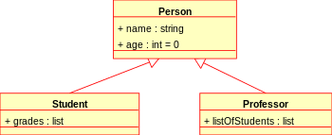
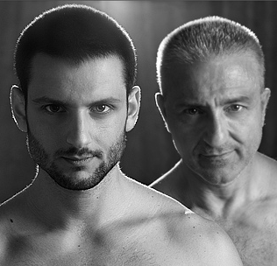
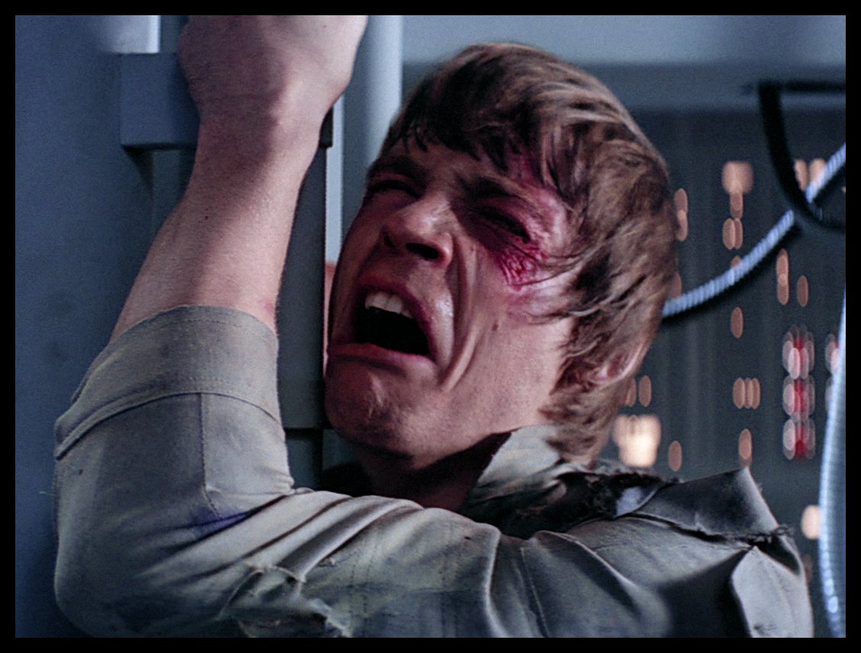
Foundation Concepts
Inheritance
“Is-A” relationship
A cat is a mammal
Subtype-Polymorphism
aka Sub-classing
Reuse definitions

Slide 8
Exercise 1:
Inheritance

Slide 9
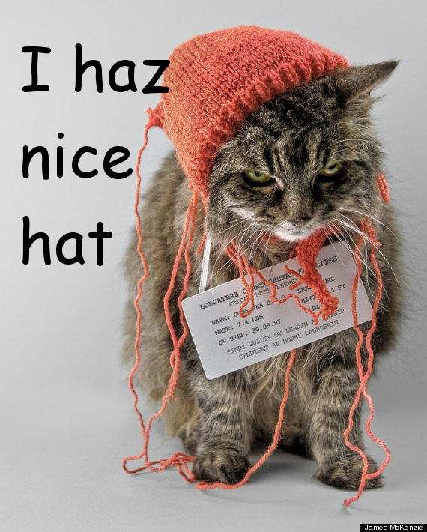

Foundation Concepts
Composition
“Has-A” relationship
A cat has a tail
May or may not share a lifecycle

Slide 10
Exercise 2:
Composition

Slide 11
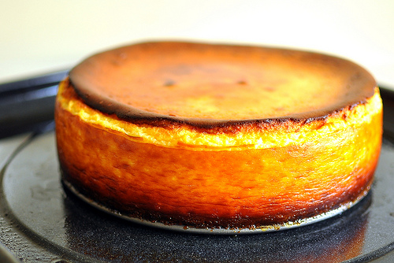
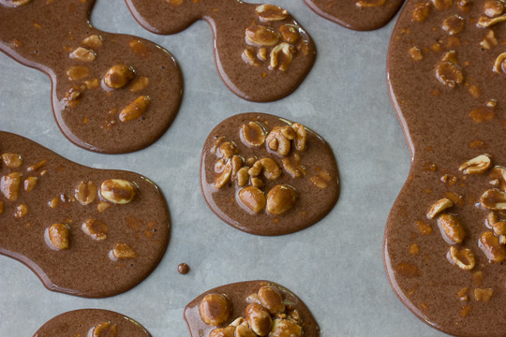
Foundation Concepts
Cohesion
Do one job
One reason to change
One concept encapsulated

Slide 12
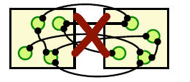
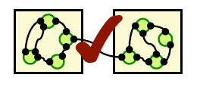
Foundation Concepts
Coupling
What do you need to get things done?
What needs you to get things done?
Trade-off against cohesion
Zero coupling = big ball of mud
Aim to stay Loose

Slide 13
Exercise 3:
Back at the Zoo

Slide 14
Principles
The simplest thing
that works
YAGNI
You
Aren't
Going to
Need
It
For real applications this only works if;
You refactor
You have tests
Complexity is the enemy

Slide 15
A note on Complexity
“Designing software is an exercise in managing complexity”
Jim Reeve - C++ Journal (1992)
Necessary Complexity
Solving hard problems
Accidental Complexity
Gold plating, poor design, premature optimisation, …
Complexity is a cart full of stones, slowing us down

Slide 16
Principles
Don't Repeat Yourself
Every copy-and-paste is another stone in the cart
Two places to fix bugs
Two places to make a change
Two things to understand

Slide 17
Principles
The Principle Of Least Surprise
What would you expect from an API?
What would you hope for in the implementation?
When in doubt
Do the right thing.

Slide 18
Principles
Single Responsibility
O
L
I
D
Do one thing
High Cohesion
DRY
A place for everything, and everything in it's place

Slide 19
Principles
S
Open Closed
L
I
D
Open for Extension
Subclassing
Interface implementation
Closed for modification
Only changes if it's requirements change

Slide 20
Principles
S
O
Liskov Substitution
I
D
"New classes should be logical, consistent extensions of their super-classes"
Barbera Liskov (1987)
The client of an API shouldn't need to know about different implementations
Principle of Least Surprise

Slide 21
Principles
S
O
L
Interface Segregation
D
It's better to depend on a small interface than a large one
It's better to implement a small interface than a large one
Break large interfaces down into smaller ones

Slide 22
Principles
S
O
L
I
Dependency Inversion
High-level modules should not depend on low-level modules. Both should depend on abstractions.
Abstractions should not depend upon details. Details should depend upon abstractions.
BDD helps here
Dependency Injection helps too

Slide 23
Principles
Law Of Demeter
Formally, the Law of Demeter for functions requires that a method m of an object O may only invoke the methods of the following kinds of objects:
O itself
m's parameters
Any objects created/instantiated within m
O's direct component objects
A global variable, accessible by O, in the scope of m

Slide 24
Principles
Law Of Demeter
Principle of Least Knowledge
It's all about encapsulation, coupling & cohesion
An object should avoid invoking methods of a member object returned by another method.
Use one dot

Slide 25
Exercise 4
Cash Machine

Slide 26
Practices
Micro types
Capture the concept of domain types
Strongly-typed
e.g. Order ID
update(String orderId, String reasonCode)
update(OrderID id, Reason reason)
Collections
public class Orders extends List<Order>{...}

Slide 27
Practices
Design Patterns
Solutions for common problems
Encapsulate variations
A common language / shorthand
BUT
They're not where you start, they're where you finish
Refactor to patterns
in response to code-smells

Slide 28
Practices: Design Patterns
Creational
Factories
Encapsulate the knowledge of how to build different variations of a type
Builders
Encapsulate how to assemble families of related objects
Singleton
Manage the lifecycle of expensive or scarce resources
Doesn't need to be global shared state

Slide 29
Practices: Design Patterns
Structural
Adaptor
Translate between different protocols (encapsulate the differences)
Facade
Hide a complex API behind a simpler one
Decorator
Wrap one object in another of the same type and add behaviour
Java IO libraries
Composite
Homogeneous tree structures e.g. Files/Directories

Slide 30
Practices: Design Patterns
Behavioural
State
Encapsulate differences in behaviour into objects
Common refactoring for big conditional blocks
Strategy
Encapsulate different algorithms
Iterator
Encapsulate how to traverse a structure
Built in to most languages

Slide 31
Practices
Domain Driven Design
Entities
Concepts from the problem domain
Data and behaviour
Services
Logic which doesn't belong to an entity
Value Objects
Immutable containers for data

Slide 32
Practices
CRC Cards
Classes, Roles, Collaborators

Slide 33
Practices
UML
An industry standard
But useful anyway
A tool for communication
Delivers no features
Can be generated from code
Short lifetime otherwise
Divergence from reality

Slide 34
Practices: UML
Class Diagram
Static relationships
Hierarchies
Whiteboard
Generated from code

Slide 35
Practices: UML
Sequence Diagram
Dynamic interactions
Useful communication tool
Really useful conversation tool

Slide 36
Practices: UML
State Diagram
Dynamic behaviour
Fits well with State pattern

Slide 37
Exercise 5
Group Therapy
Notes:
What is the worst / most-interesting violation of OO principles you’ve come across?
Phrase in terms of coupling/cohesion/SOLID etc.
What did / would you do to fix it?
Why is that better?

Slide 38
Closing Thoughts
It will never be perfect
The key to good design is knowing when to stop
Protect yourself with Tests
Accept change
Principles apply at different scales
As below, so above
Intra-module
Inter-module/Intra-system
Inter-System
B2B

Slide 39
Closing Thoughts
Do the right thing
YAGNI
Make it Work
Make it Right
Make it Fast
DRY
Single Responsibility Principle
Seek feedback
Keep Learning

Slide 40
The Golden Rule
“Always code as if the person who ends up maintaining your code is a violent psychopath who knows where you live.”
Ward Cunningham

Slide 41
Retrospective
Post-its on the table
What you liked
What you missed
What was confusing

Slide 42
Spare Slides

Slide 43
Principles
Zero
One
Many
Will there always just be one of these?
Yes: design for one
No: design for many

